Slide 1


SIMATS ENGINEERING
SAVEETHA INSTITUTE OF MEDICAL AND TECHNICAL SCIENCES
Harris Corners for Whiteboard Content Extraction
DSA0205- Computer Vision with Open CV
Abdul Razak Shaik (192524358)

Slide 2
ABSTRACT
Harris Corners for Whiteboard Content Extraction is a computer vision technique used to identify important points in a whiteboard image.
The Harris Corner Detection algorithm detects corners by analyzing changes in image intensity in different directions.
First, the whiteboard image is preprocesssed to reduce noise and convert it into a suitable format.
Then, Harris corner detection is applied to identify strong corner points present in handwritten text, diagrams, boxes, and lines.
The detected features can be used to locate and extract useful whiteboard content.
This method can help in digitizing classroom notes, meeting discussions, and handwritten information for further processing such as OCR and document analysis.

Slide 3
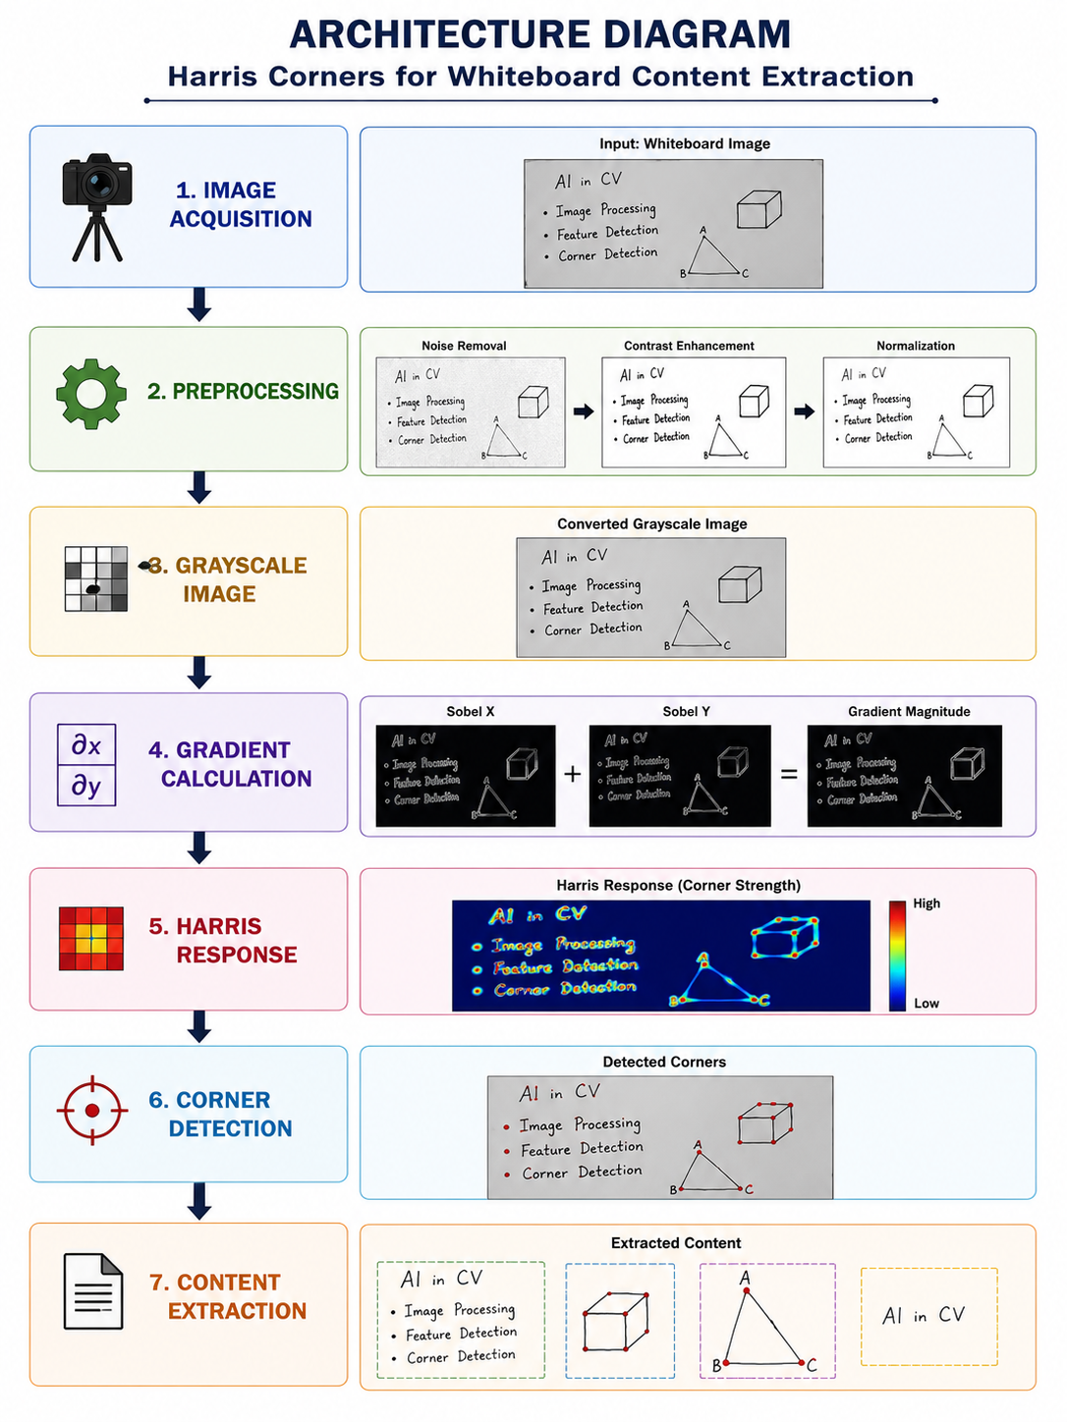

Slide 4
THANK YOU

